Slide 1

EVENTRRA
MAKE YOUR MOMENTS MEMORABLE...
AARTHI M
BALAJI P
DEEPEKA S
DENESH A

Slide 2
AGENDA...
ABSTRACT
INTRODUCTION
PROBLEM STATEMENT
PROPOSED SOLUTION
ARCHITECTURE DIAGRAMS
ANALYSIS AND FINDINGS
MERITS
OUTPUT SCREENSHOTS
GITHUB LINK
CONCLUSION
REFERENCES

Slide 3

abstract
Eventrra is an event management website where user can book their event and make their occasions more special and memorable. Special occasions like weddings, corporate occasions, birthday celebrations, Concerts , from A-To-Z user say it or user can customize it and we will have it done for them. Motive of Eventrra is to bring all factors together to produce a workable event.

Slide 4
Introduction...
To develop enterprise software that optimizes the performance of an event management company.
The system helps the firm to receive the orders from different clients irrespective of their location.
The system enables even the remote client to make online registrations.
It provides a flexible web outlet to engage more clients in the process of event management process.

Slide 5
Problem statement...
Every Organization, whether big or small, has challenges to overcome and managing every event. Currently Event Management system is manual and only accessible to staff. The client has to travel to the company offices in order to schedule, book and organize an event such as Birthday Party, Marriage, Reception, Ring Ceremony. Clients pay cash to book an event which is inconveniencing when customers are many at the company. It takes lots of time of customer because they have to search such event organizer and contact them individually so an online event management system is needed which will enable the customer make booking, schedule events online at any preferred time.

Slide 6
Proposed solution...
Management System has different event needs, so we design exclusive Event Management System. This is designed to assist in strategic planning, and it will help to ensure that your organization is equipped with the right level of information and details of your future goals. Also, for those busy executive who are always on the go, Our system come with remote access features, which will allow you to manage your workforce anytime. These system will ultimately allow you to better manage resources.

Slide 7
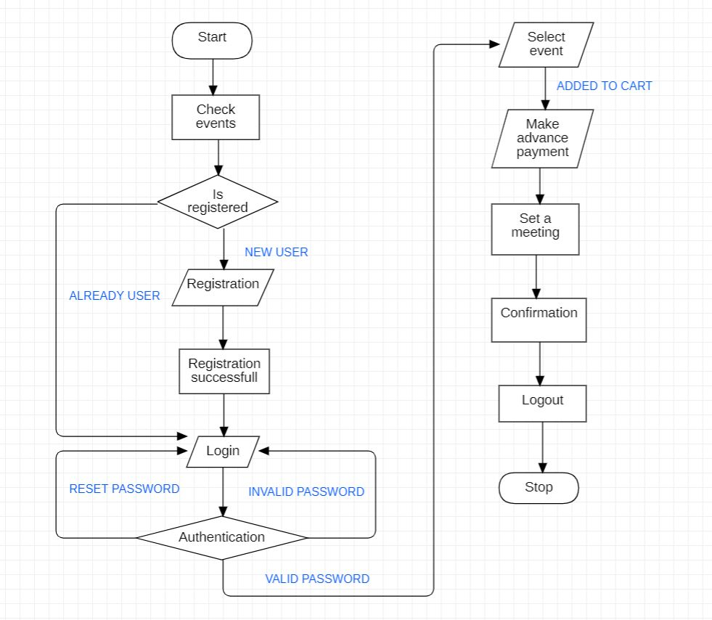
FLOW CHART...

Slide 8
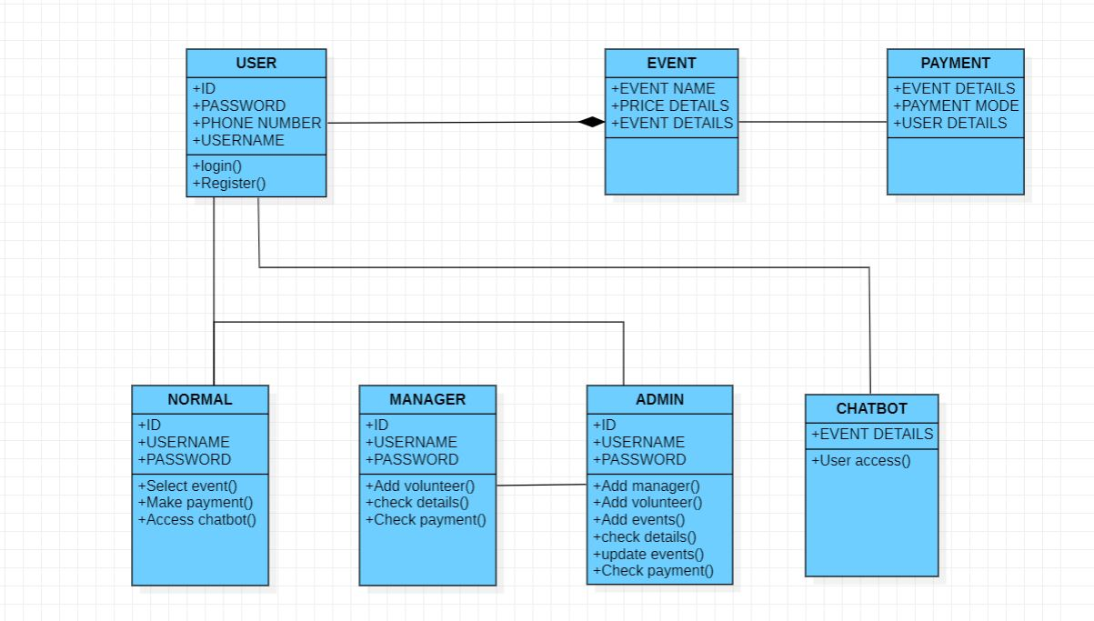
class DIAGRAM...

Slide 9
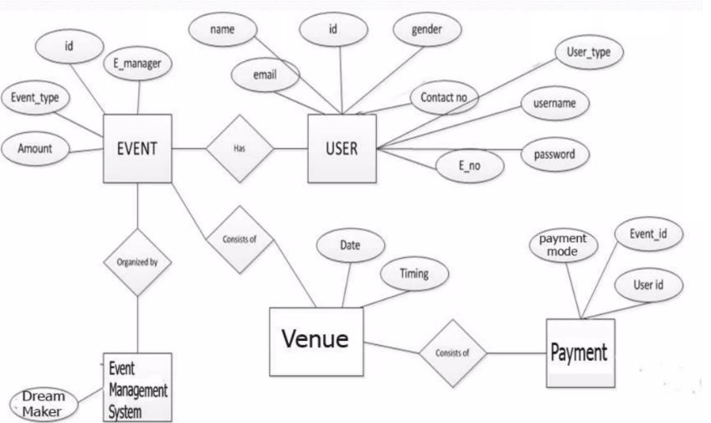
ENTITY-RELATIONSHIP DIAGRAM...

Slide 10
Analysis and findings
The use of a paper-file system to record, process and monitor event booking data, financial data and personnel data causes a delay in decision making. This is so because managers get limited time to analyze the information for proper decision-making process. Hence this has been corrected in our system to enhance fast process. More Options on events are not available which will be enhanced in future.

Slide 11
Merits....
Event management system manages all the event
System can very efficiently store, maintain and retrieve data from its database and can be use for for further analytics.
Time saving activity.
Manual hours that need to spend in record keeping and generating reports is no longer required.
Cost of maintaining is less because only one time development efforts required, hence it is economically feasible.

Slide 12
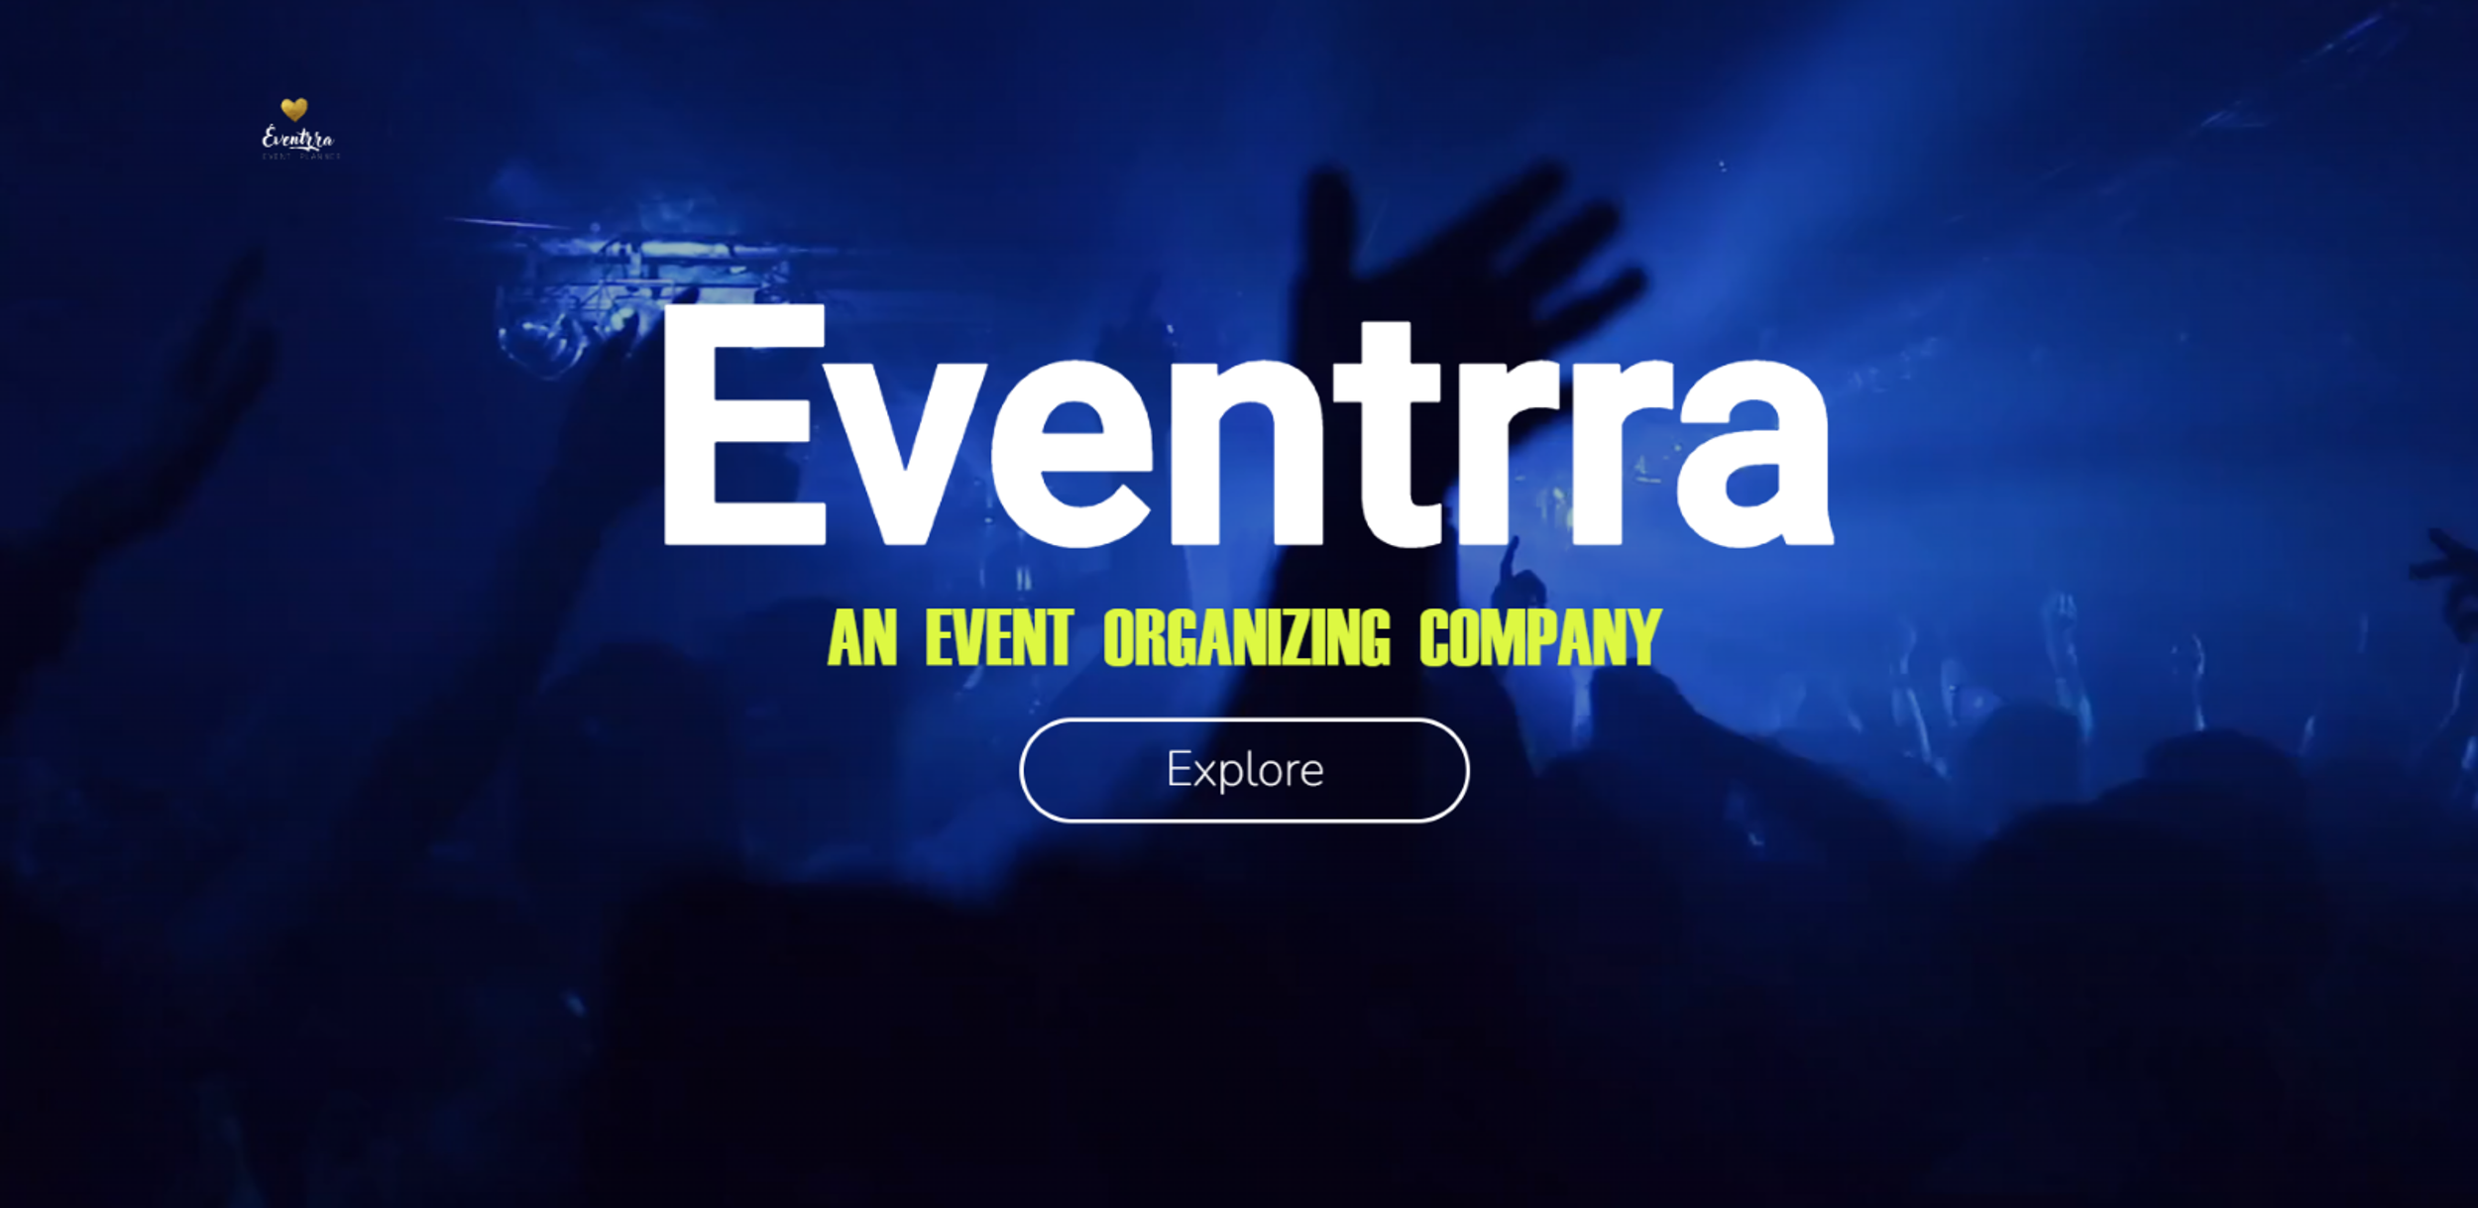
screenshots

Slide 13
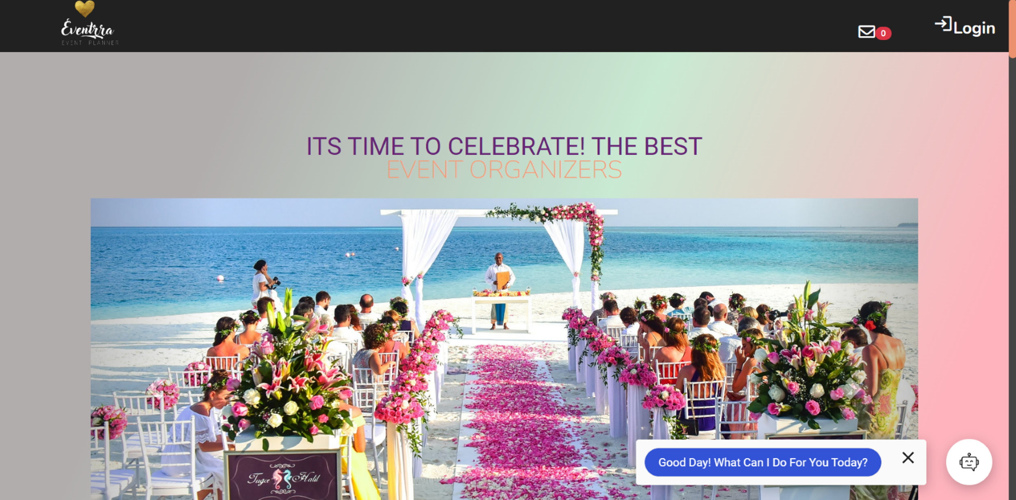

Slide 14
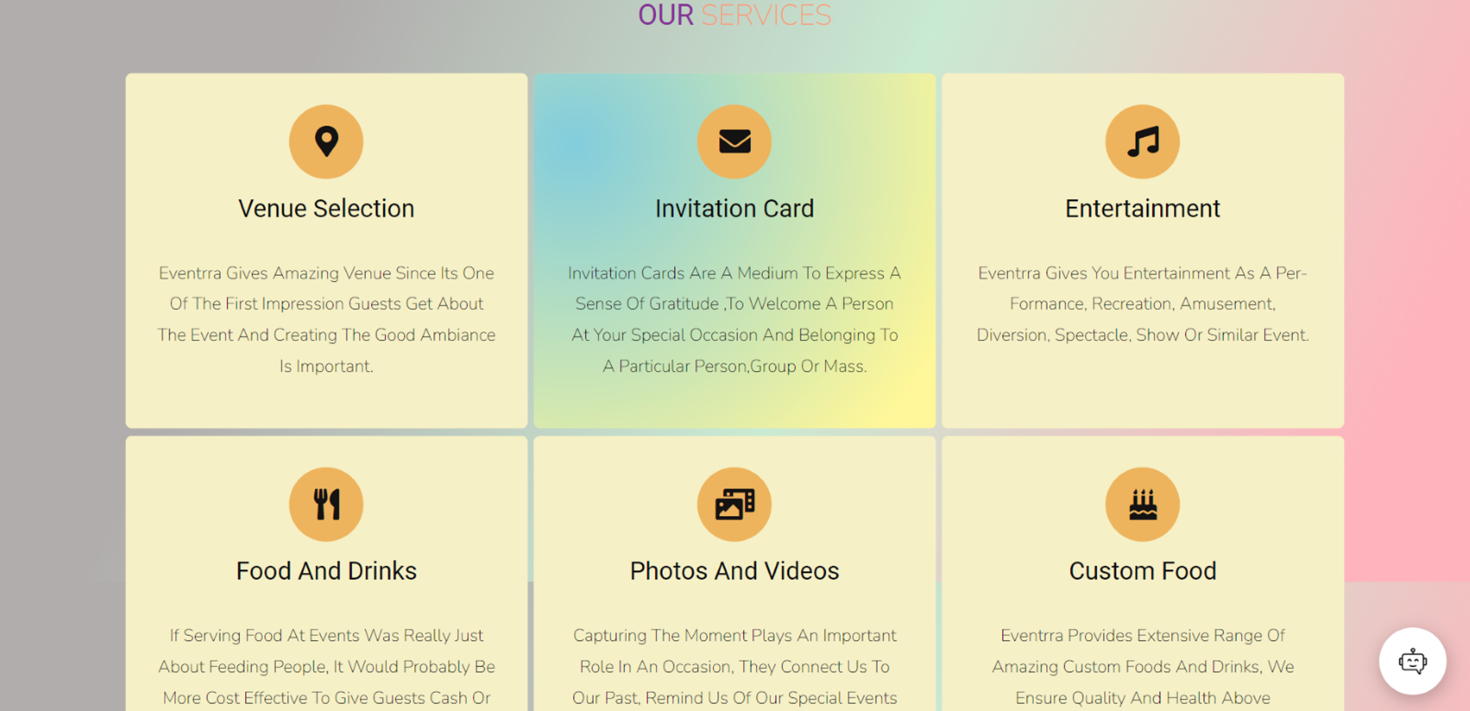


Slide 15
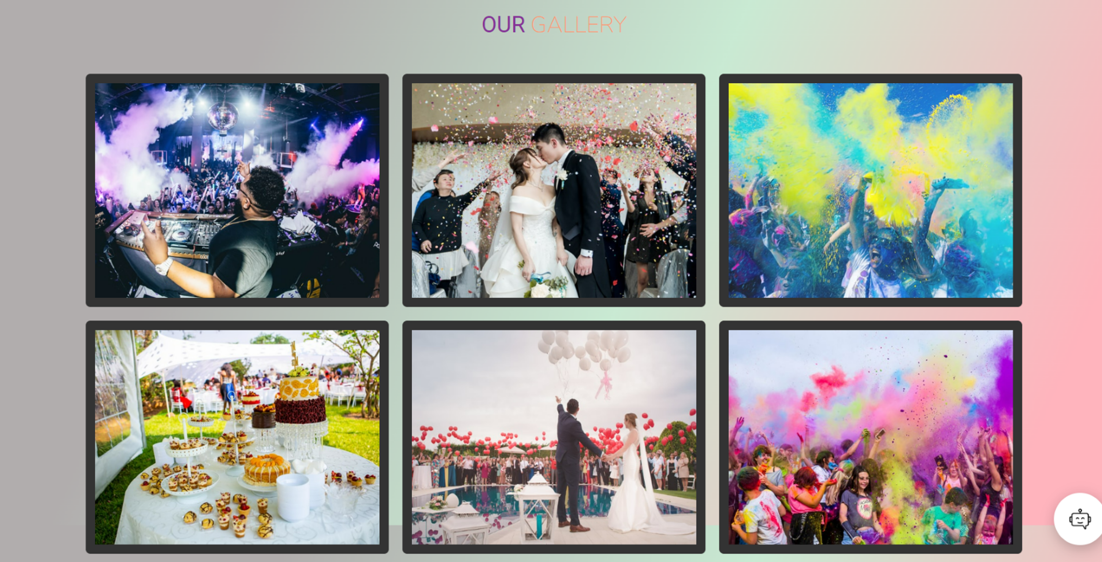
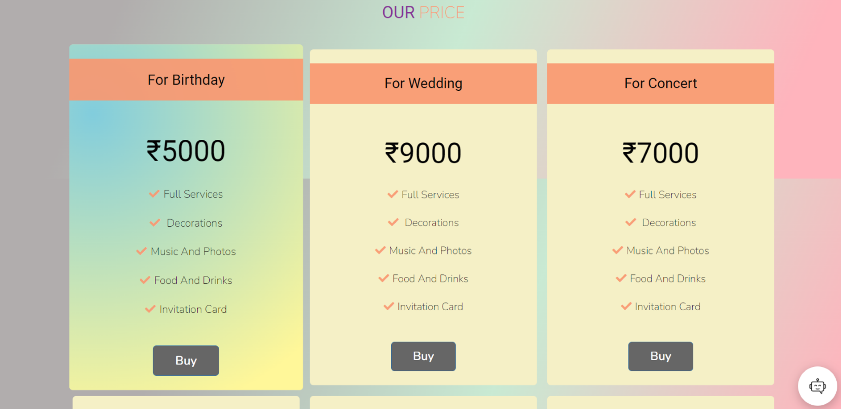
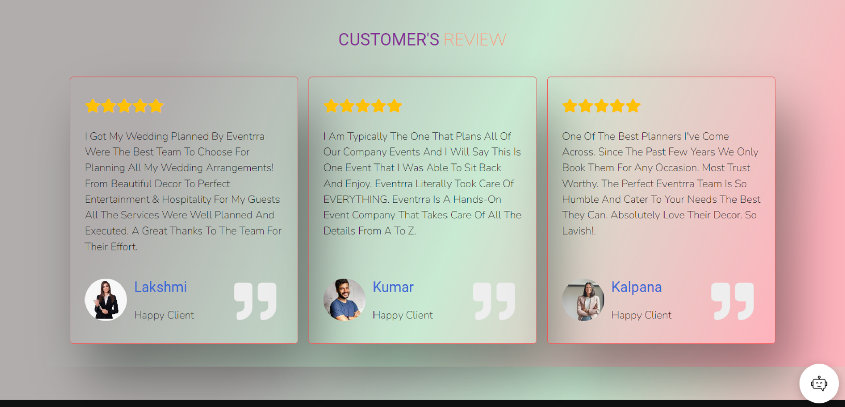
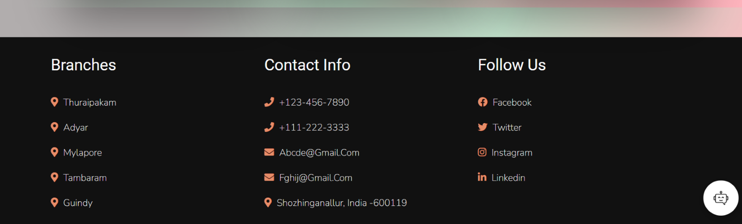

Slide 16
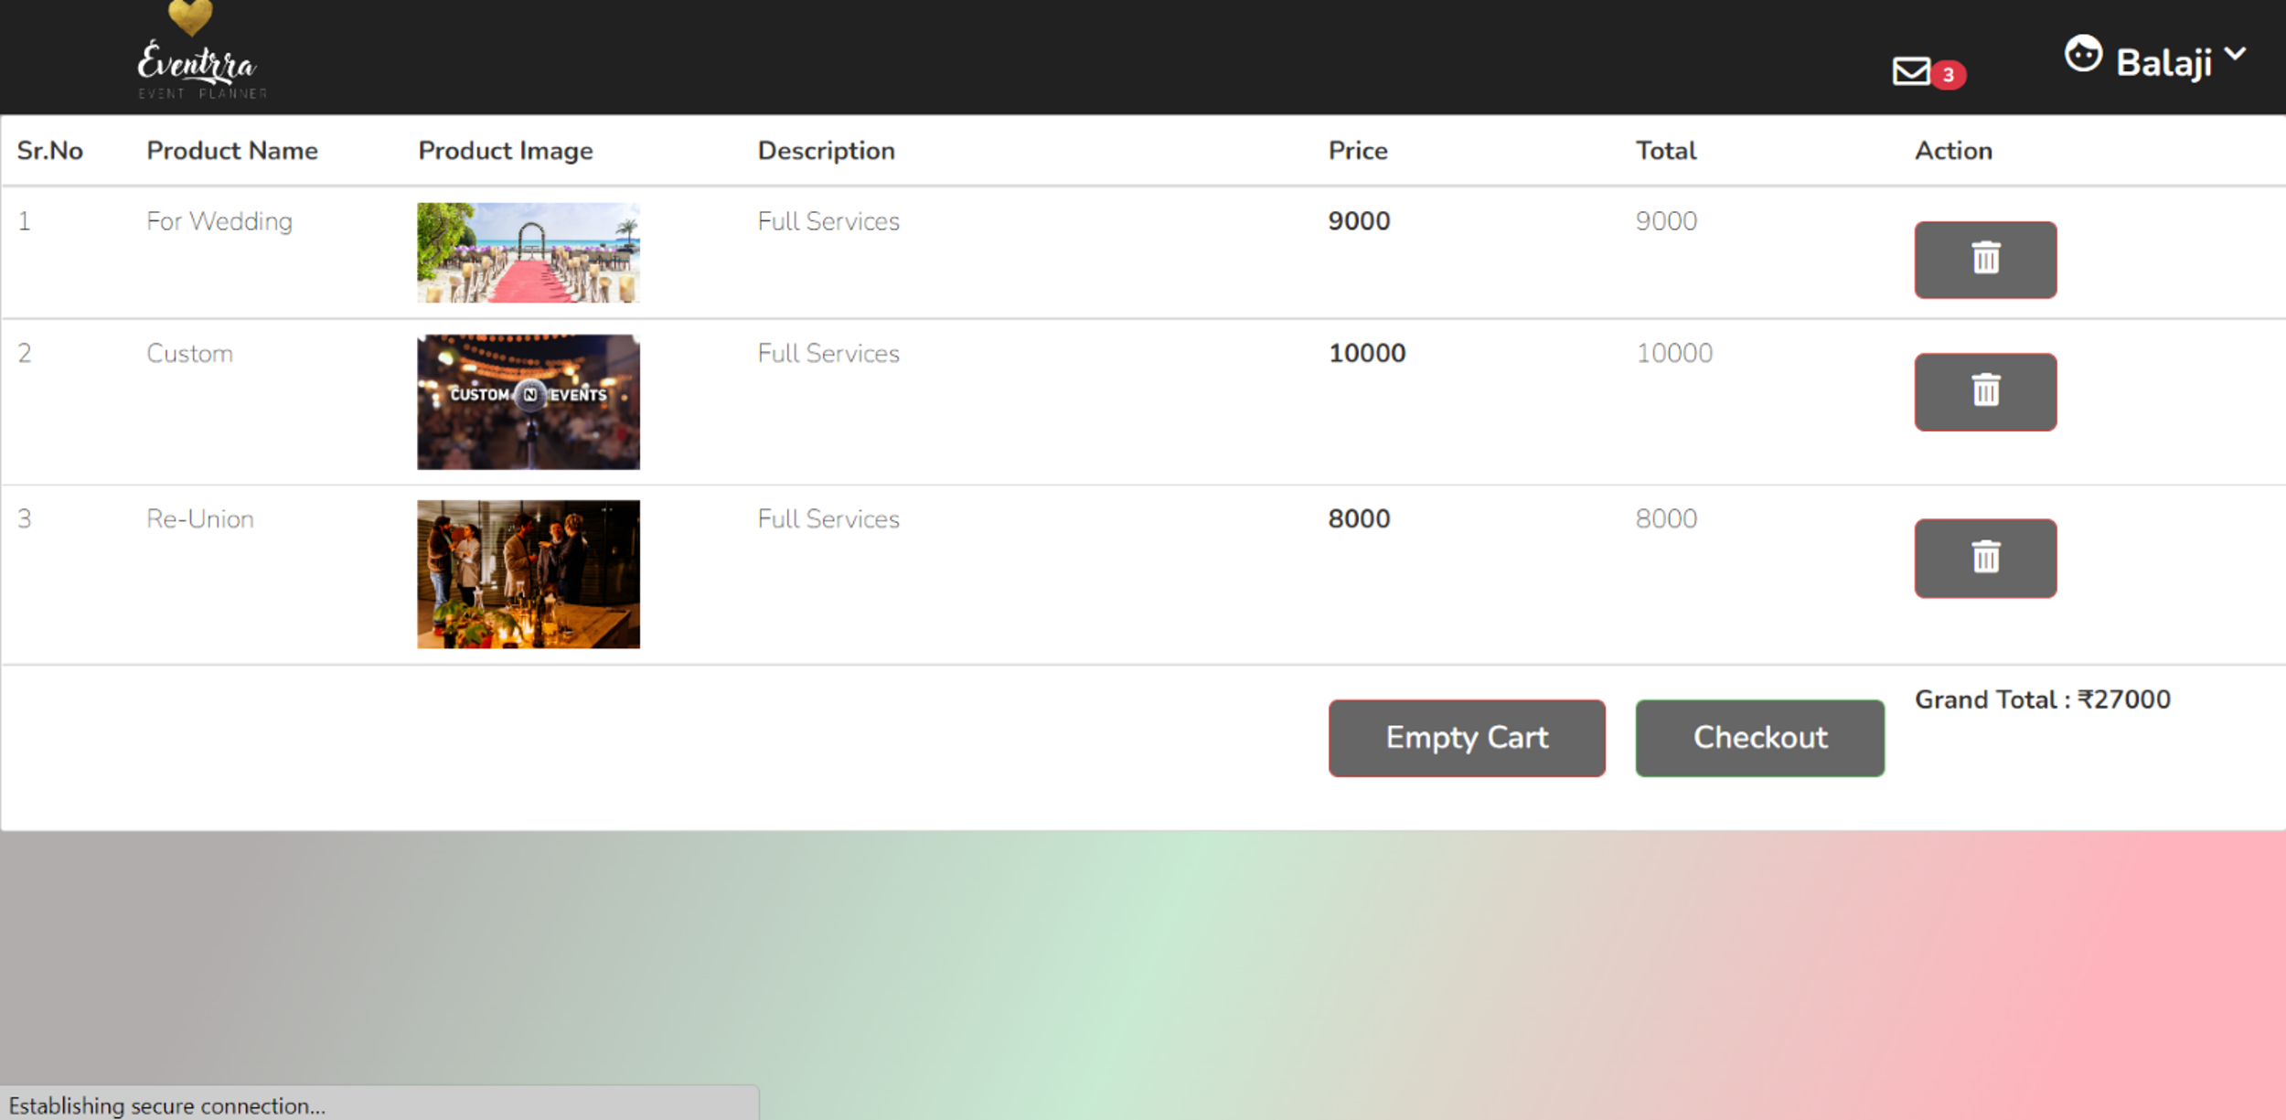
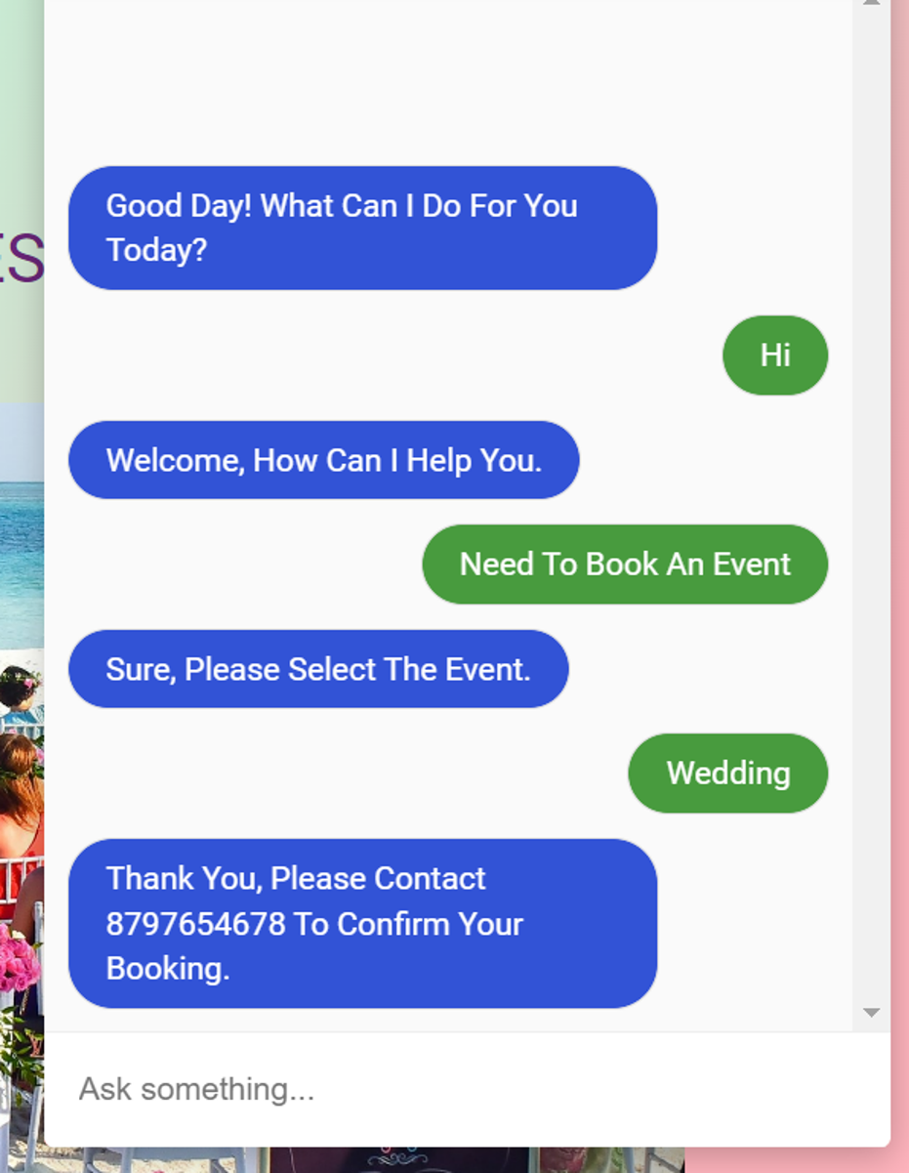
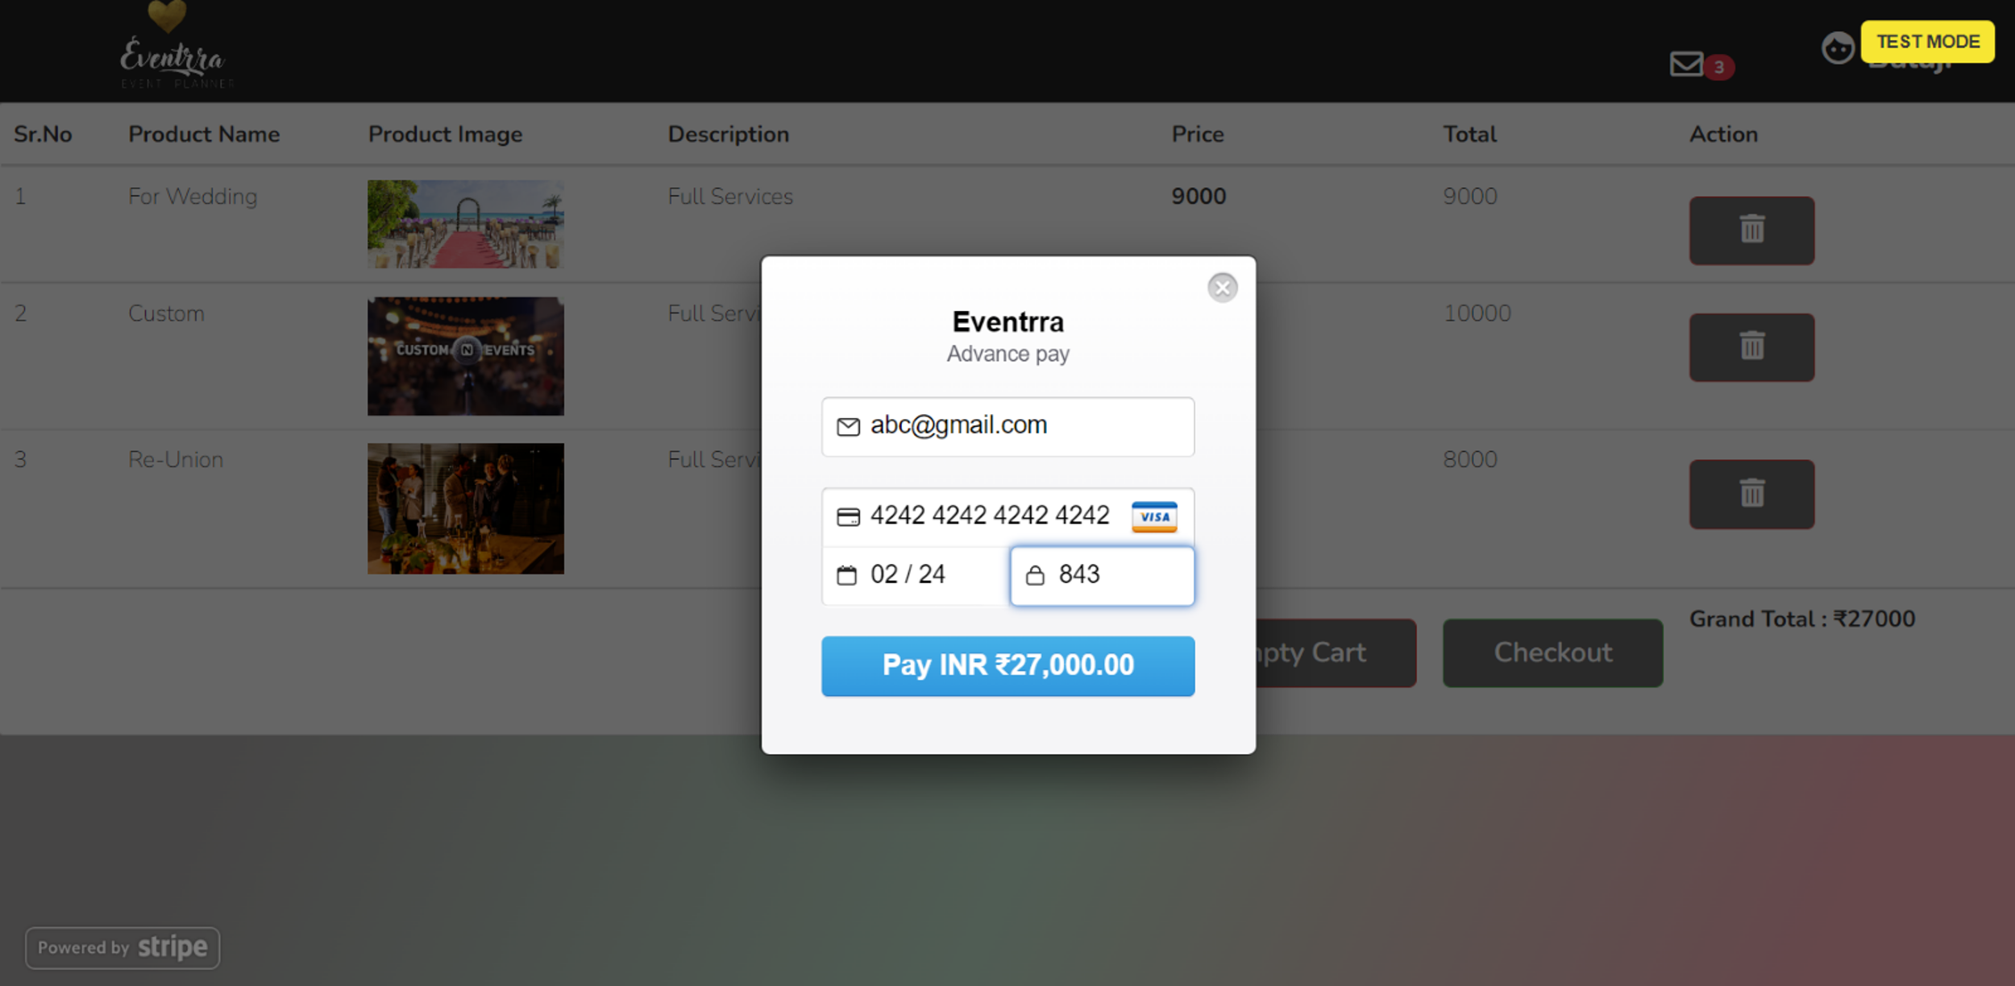

Slide 17
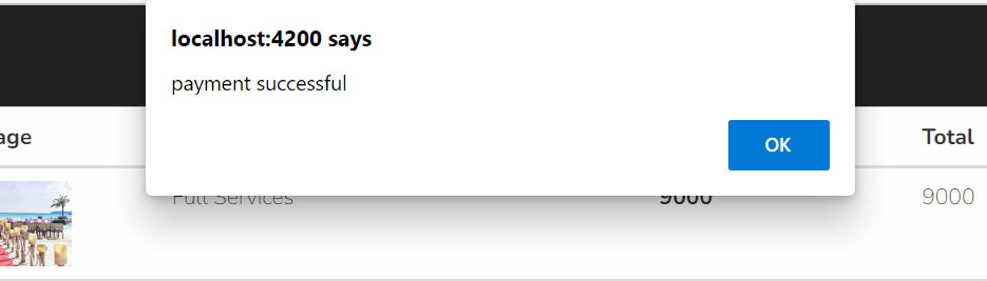


Slide 18
conclusion
Event management requires excellent communication, management, planning and control skills. An event management framework involves such concepts as technology, structure, effectiveness, and fit. Each of the concepts has great impact on the modern organization and its functions. The correlation between these measures and measures of arrangement indicates how well the management decisions matches structure. Modern project management does not reveal much about how the important properties of these systems should be measures.

Slide 19
references
[1] Goldblatt, Joe. Twenty-First Century Global Event Management (The Wiley Event Management Series) ISBN 0-471-39687-7.
Link:Goldblatt, Joe. Twenty-First Century Global Event Management (The Wiley Event Management Series) ISBN 0-471-39687-7 - Search (bing.com)
[2] Referred angular routing from W3 School.
Link:https://www.w3schools.com/angular/angular_routing.asp
[3] Parry, A. (2022). Event planners rejoice as a new type of event staff provider launches a book. from http://www.eventindustrynews.co.uk/2013/03/20/event-planners-rejoice-as-a-new-type-of-event-staff-provider-launches-in-london/

Slide 20

THANK YOU

